Slide 1

MGMT 590 Web Data Analytics
GAP Case Study
Group 7

Slide 2




Meet the Team
Shivam Mishra
Pratiksha Gupta
Keertana Madan
Priyanka Shinde

Slide 3

Introduction
The case study delves into Gap Inc., specifically focusing on the challenges faced by the company in January 2017 under the leadership of its CEO, Art Peck
He introduced data-driven decision making measures to turnaround two years of declining sales
The study is on the analysis of the approach. We are focusing on three brands of GAP Inc. namely Gap, Banana Republic and Old Navy

Slide 4
Data Driven Creative Process at GAP Inc
Data-Driven Decision Making
more personalized shopping experience
voice of the customer initiatives
Operations optimization
shifted some manufacturing from Asia to the Caribbean
Firing of Creative Director
Email Personalization and Geosniffing
testing of product
each brand’s vision statement served as a filter
closing of stores.
emphasized Gap's digital and mobile e-commerce platforms
large quantities of fabric and holding
Cutting the development cycle down
consistent with the brand’s image instead of creative director specific
analysis of customer purchase data
Product 3.0
The case study highlights Art Peck's strategic approach to addressing Gap Inc.'s challenges as he led the company's growth, innovation, and digital initiatives.

Slide 5
Was firing Creative Directors a sound decision?
Decision-making is more objective and consumer focused
Cater to a broader audience by understanding their specific needs.
Ability to quickly adapt to changing market trends.
Recommendation : A hybrid model where data informs creative decisions could have been a more balanced approach.
Pros
Cons
completely sidelining human creativity might not be the best approach
Loss of delicate balance between data-driven insights and creative artistry
Potential alienation of core customers loyal to core designs
Loss of creative vision

Slide 6
Analysis Approach
Data Sources
Company Websites
Analysis Techniques
Insights
Consumer Behaviour Data
Text Analysis
Time Series Analysis
Sentiment Analysis
Opinion Mining
Key Word Analysis
Regression Modelling
Business Process Insights
Product Insights
Customer Reviews and Feedback
Competitor Data
Social Media
Notes:
https://get.pxhere.com/photo/job-office-collaboration-design-interior-design-white-collar-worker-conversation-learning-employment-hand-desk-furniture-interview-building-team-gesture-management-1535603.jpg
https://pixnio.com/free-images/2017/08/29/2017-08-29-16-04-13-1000x667.jpg
https://pixnio.com/free-images/2020/09/01/2020-09-01-09-33-31-1200x800.jpg
https://live.staticflickr.com/65535/50938102118_144ee02523_b.jpg

Slide 7
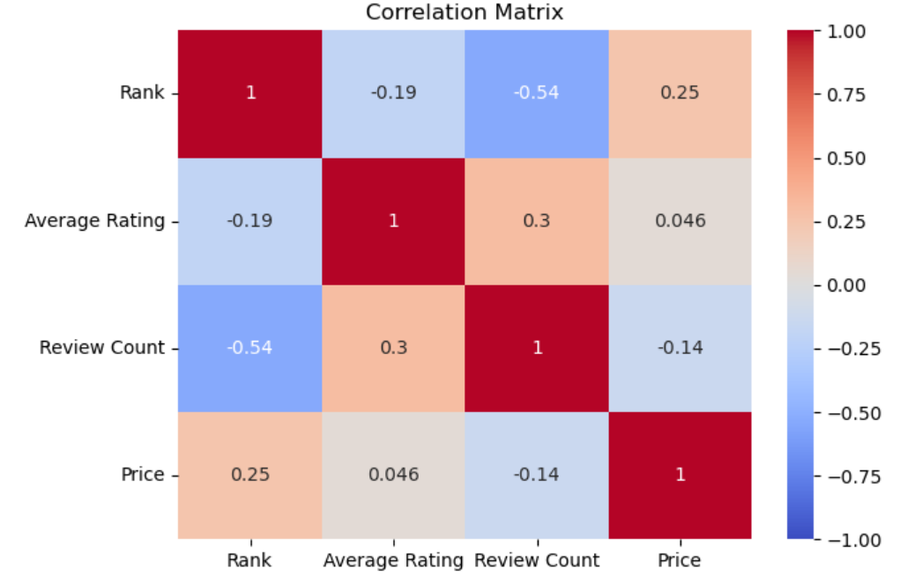
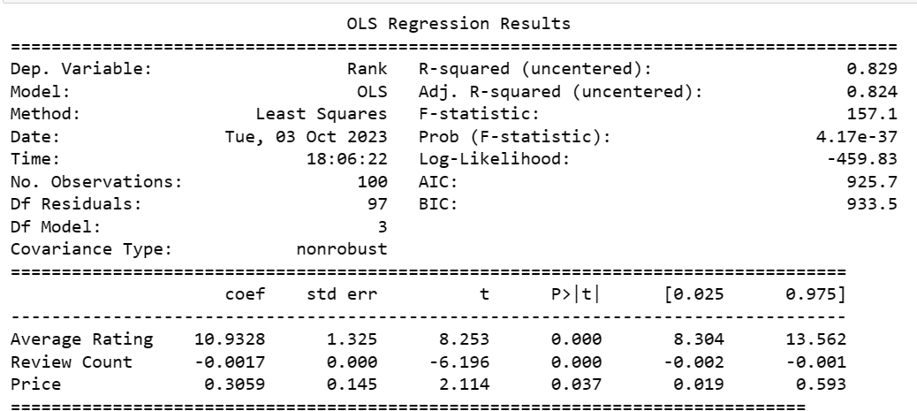
Regression Model Predicting Best-Seller Hoodie Rankings on Amazon
Rank = β1×Average Rating + β2×Review count+ β3×Price
Our Equation : Rank = 10.9328 Average Rating - .0017 Review Count + 0.3059 Price
The R-squared value is 0.829. This suggests that approximately 82.9% of the variation in the dependent variable 'Rank' can be explained by the independent variables (Average Rating, Review Count, and Price).
1 unit increase in the average rating, leads to rank increase by 10.9 units
1 unit increase in the review count, leads to rank decreases by 0.0017
1 unit increase in the price, leads to rank increase by 0.30 units
Notes:
https://runrepeat.com/average-price-soccer-cleats
exp(2.11956) – 1*100
A change in X by one unit (∆X=1) is associated with a (exp(B1) - 1)*100 % change in Y
On performing a linear modelling we found that demand is affected by following attributes greatly:
(Call out the pointers)
Reebok should clearly focus on the midsegment portion where mid price segment and demand match

Slide 8
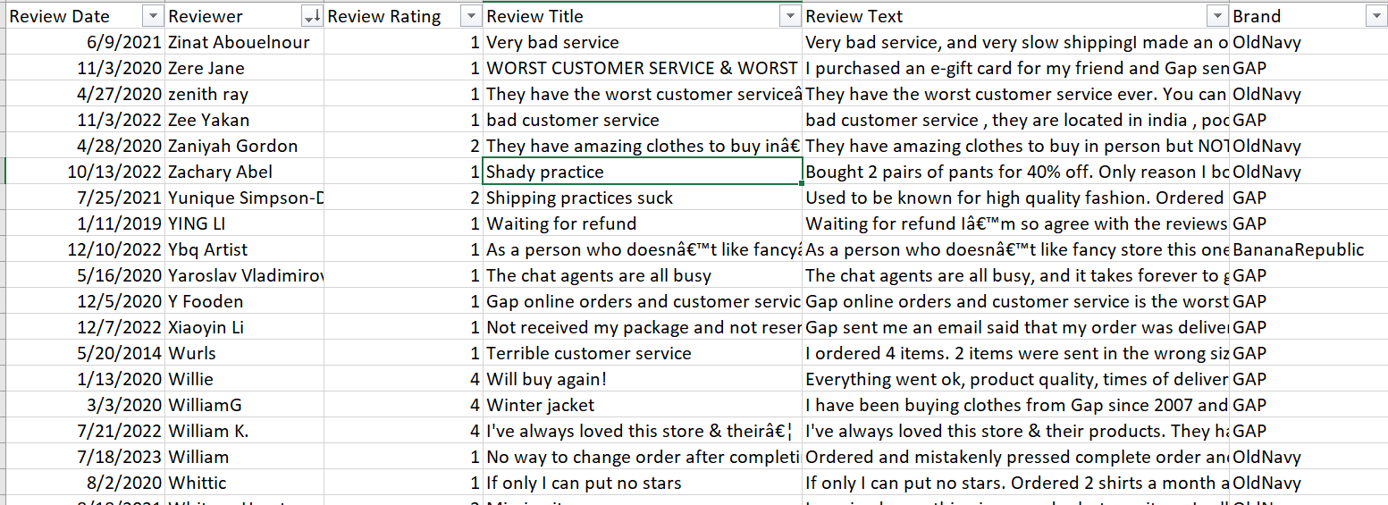
Customer Feedback Analysis: Trustpilot Reviews for Gap, Old Navy, and Banana Republic
Insights
Gap customers frequently commend the quality and overall shopping experience in positive reviews, while negative feedback predominantly points to concerns with order processing and customer service.
Old Navy order-related issues and customer service are frequent topics in both positive and negative rev.
Banana Republic the online shopping experience and specific products are praised, while customer service and order issues appear in negative feedback.

Slide 9
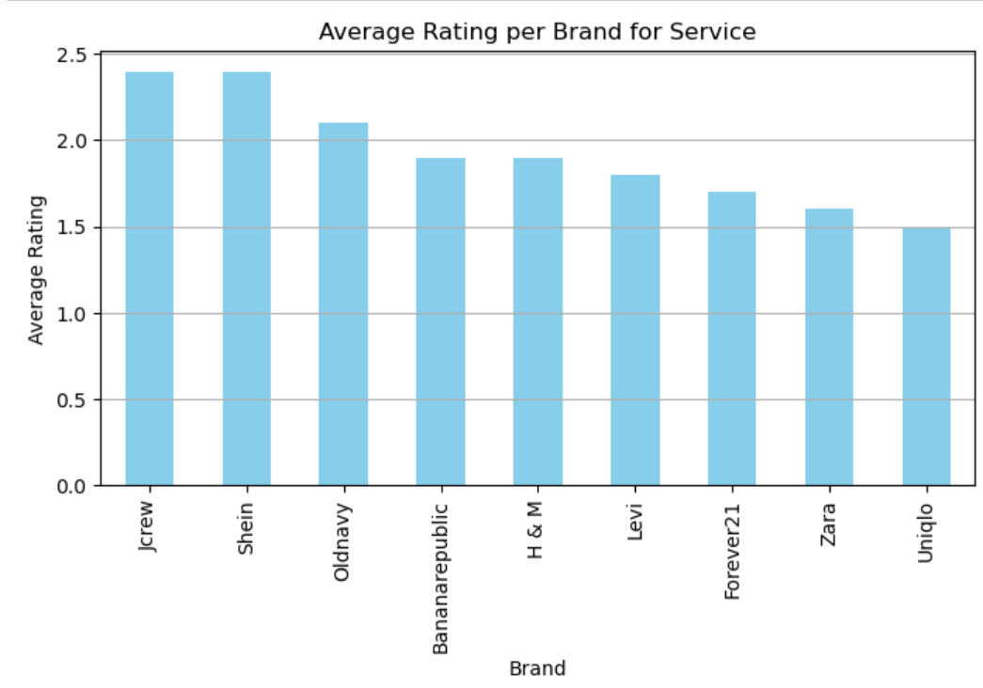
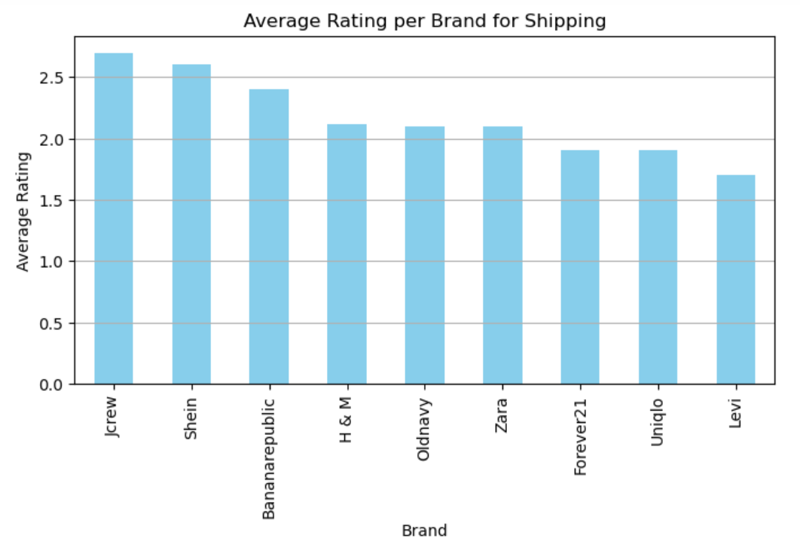
CSAT Competitor Trend Analysis from Sitejabbar Reviews
Old Navy and Banana Republic are trailing J.Crew and Shein in performance metrics like shipping and service, to remain competitive, they should benchmark against these leaders, leveraging insights from customer feedback and service features. This will optimize their offerings and potentially boost ratings, leading to improved customer ratings and brand loyalty

Slide 10
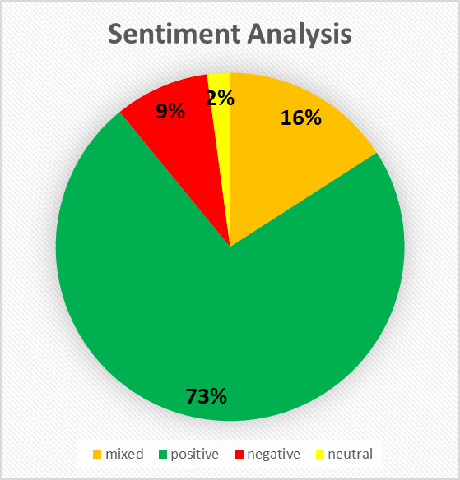

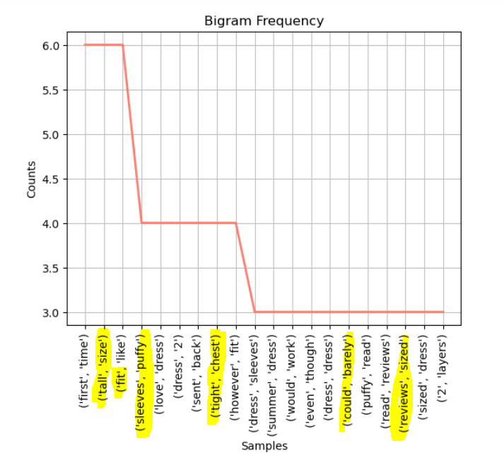
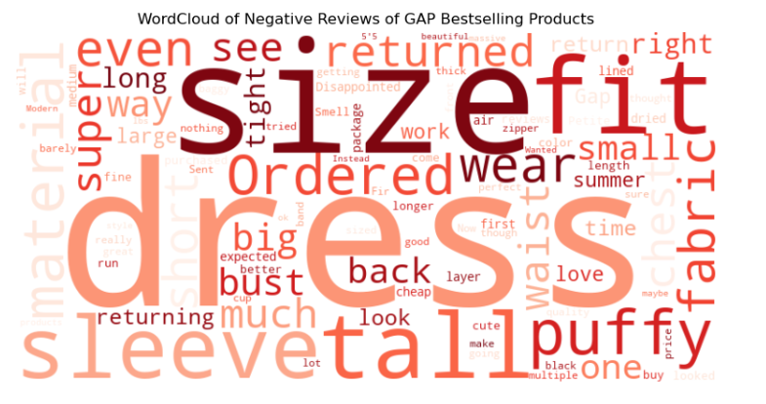
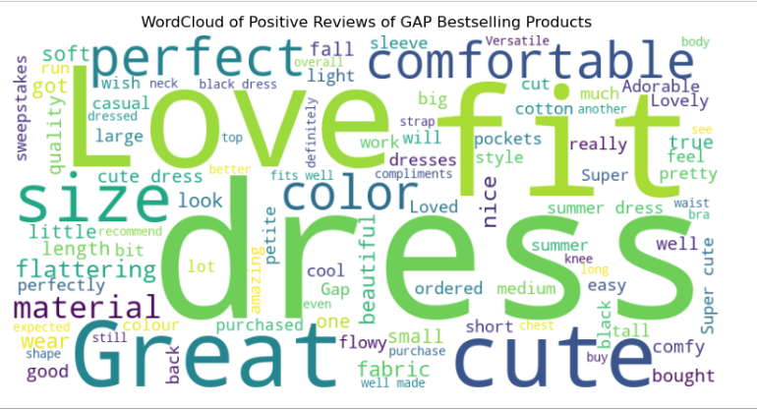
Key Insights - GAP Reviews Analysis
Analyzing the conversations and reviews from the GAP website can speak volumes in terms of what is working for the brand and customer pain-points. This approach can be replicated for Banana Republic and Old Navy websites also similarly to uncover similar insights
1
2
3
4
Keyword Analysis
Text & Opinion Mining Positive Feedback
Text & Opinion Mining Negative Feedback
GAP Product Sentiment
The most mentioned keywords relevant to poor reviews are – size, sleeves, tall, short indicating sizing improvements and design constraints
Gap customers most like the Fit, Comfort of the fabric, dresses the most from the WordCloud
Analyzing WordCloud of negative feedback indicated following improvement areas
Sizing issues
Length of dresses
Fit(Puffy sleeves)
Sentiment analysis showed that about 80% positive review from product reviews on GAP bestsellers
Notes:
Photo by bantersnaps on Unsplash

Slide 11
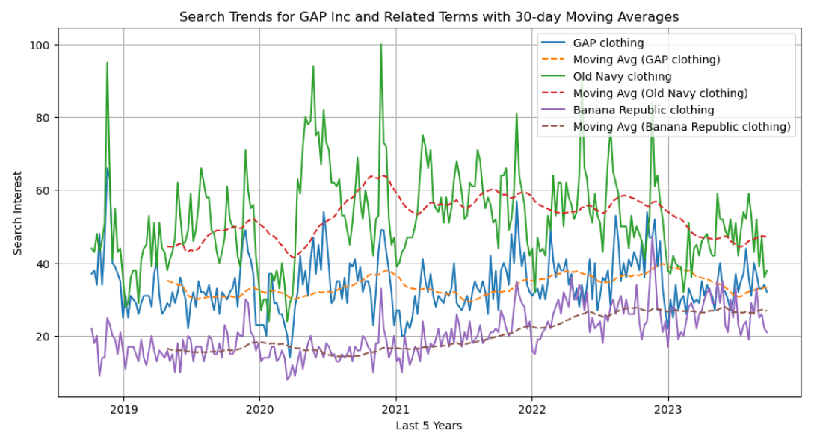
Google Trends Searches
Old Navy
The moving avg of search trend seems to decrease over time
GAP
Gap interest seems to be constant. Seems to decline in the recent past
Banana Republic
Banana Republic trends seems to increase since the past 5 years
Notes:
Photo by William Iven on Unsplash

Slide 12
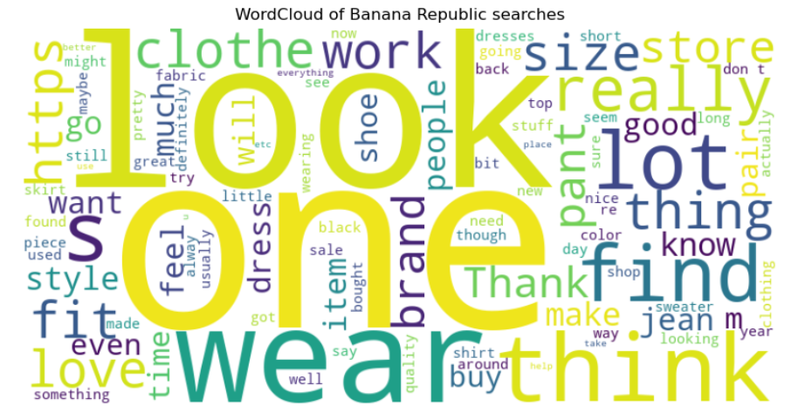
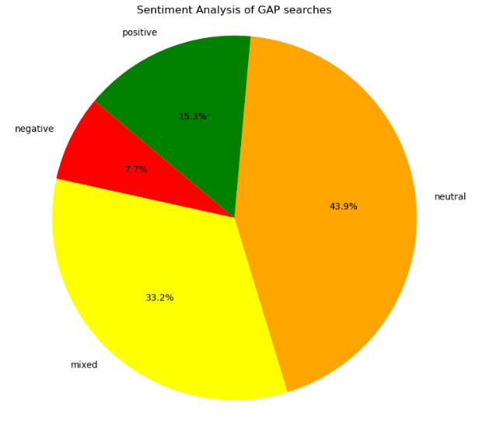
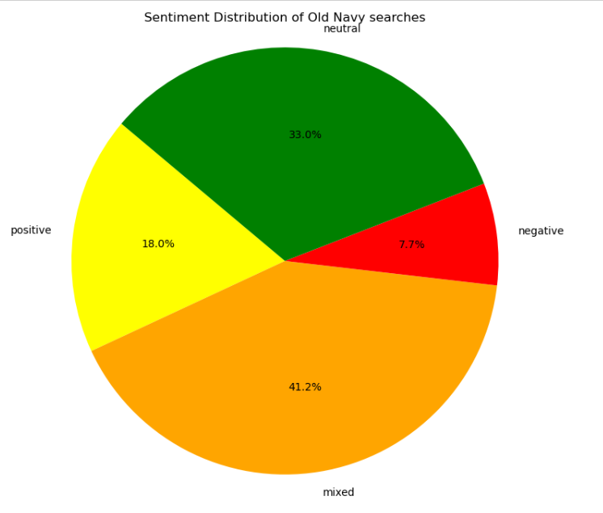
Reddit Sentiment and Text Analysis
GAP
Banana Republic
Subreddit r/femalefashionadvice
Old Navy

Slide 13
The brands of interest
 | Banana Republic | Gap | Old Navy
Creation/Acquisition | Gap Inc. acquired Banana Republic in 1983 | Gap Inc. was founded in 1969 | Gap Inc. launched Old Navy in 1994
Target Audience | upscale, sophisticated fashion | Mid-range spending capacity audience ( mass-specialty segment) | broad range of consumers, including families
Price | higher price/quality tier brand | accessible prices | budget-friendly prices
Luxury and Craftsmanship | luxurious materials and detailed craftsmanship, which justified its higher price points. | classic, clean, and comfortable basics; simplicity | No luxury element Fast fashion Discount segment

Slide 14
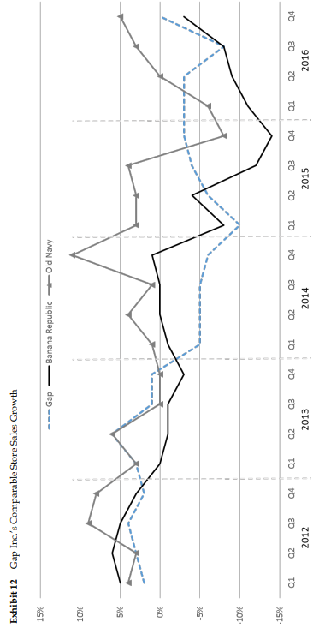
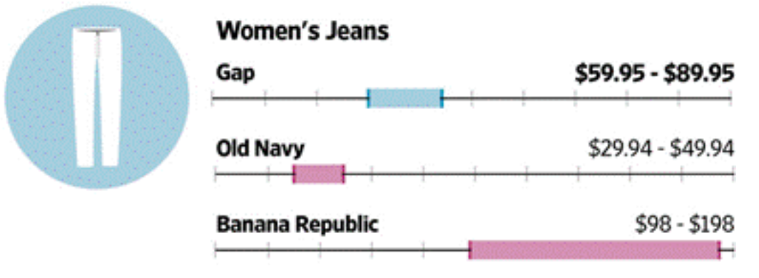
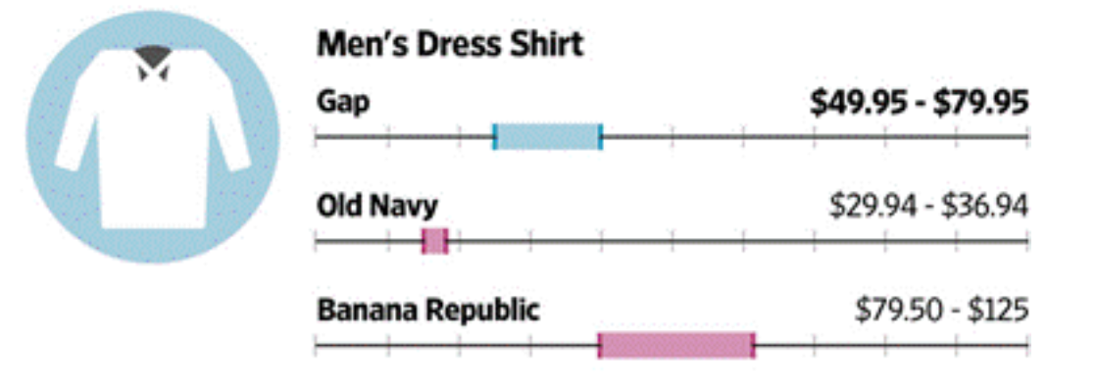
Brand differentiation within Gap Inc.

Slide 15
Does the big data approach work for all 3?
Each brand under Gap Inc. has its unique identity, target audience, and positioning while big data can provide insights across the board, its effectiveness might vary
Better Served: Both "Gap" and "Old Navy" seem to be better served by a big data approach. Given their broader target audiences and varied price points, there are potentially more data points to analyze, leading to richer insights
Worse Served: "Banana Republic" might be slightly less served by this strategy due to its niche target audience. However, this doesn't mean big data isn't useful for them. Instead, the approach might need to be more tailored, focusing on detailed segmentation and deeper insights into the upscale and professional demographics' preferences
Conclusion: While all three brands can benefit from a big data approach, the application and focus might differ based on their target audience, price range, and style. The broader the audience and product range, the more diverse data there will be, making big data approaches even more valuable. However, even for niche markets, big data can provide deep insights into specific segments, making it a valuable tool for all three brands

Slide 16
Balancing Art and Science in Marketing
Customer Segmentation
Art + Science
Balance of creativity with data-driven decisions enhance customer experience and drive growth
Creates Trend
Customer Targeting
Brand Legacy
Market Research
Brand Identity
Demand Forecast
Innovation
New Business Opportunities
Science
Art

Slide 17
Marketing Strategies
Affordable fashion
Use pricing strategy using competitors’ data and customers’ expectations
Improved User Interface
Identify pain points by tracking customer journey from product viewing to checkout/drop off point
SWOT analysis
Identify strength
Fostering creativity
Assist fashion designers and artists towards innovation to create trend
Work on weaknesses
Penetrate emerging economies
Seize opportunities
Conduct effective and
high-quality market research for penetrating emerging economies
Eliminate threats
Customization
Create personalized fashion pieces
that connect with customers on a personal an emotional level

Slide 18
.
From Regression Analysis , we infer that GAP should address low-rated reviews to improve quality, elevate ratings, and boost sales
Recommendations
Leverage the insights gained from analyzing negative product reviews to address existing customer issues and improve products
Google Trends
Incorporate Google Trends data analysis to gauge the company's general interest levels, enabling the strategic planning of discounting strategies during lowinterest periods. Furthermore, identifying high-interest periods can facilitate planning for initiatives such as new product launches.
Monitor social media to gauge the sentiment of customers and understand the overall sentiment towards the company
From regression analysis, it is inferred GAP should address low-rated reviews to improve quality, elevate ratings, and boost sales
In addition to using data driven approach for other brands, Banana Republic should focus on deveoping innovatived designs to distinguihs itself from its competitors

Slide 19
Limitations
Scalability
We have used small datasets to arrive at our conclusions. For example, only limited websites were scraped which could have been easily extended to various other websites as well.
Sample datasets
We have scraped limited data from a particular data source. For example, we did not scrape the entire Gap website which could have been done to gather more data .Optimizing our scraping techniques to gather more extensive data from these sources could enhance the accuracy and depth of our insights.
Model optimization and complexity
Since our modelling techniques are nascent, there is considerable opportunity of improvement. The parameters included are not exhaustive and there is considerable scope for improvement in the models.

Slide 20
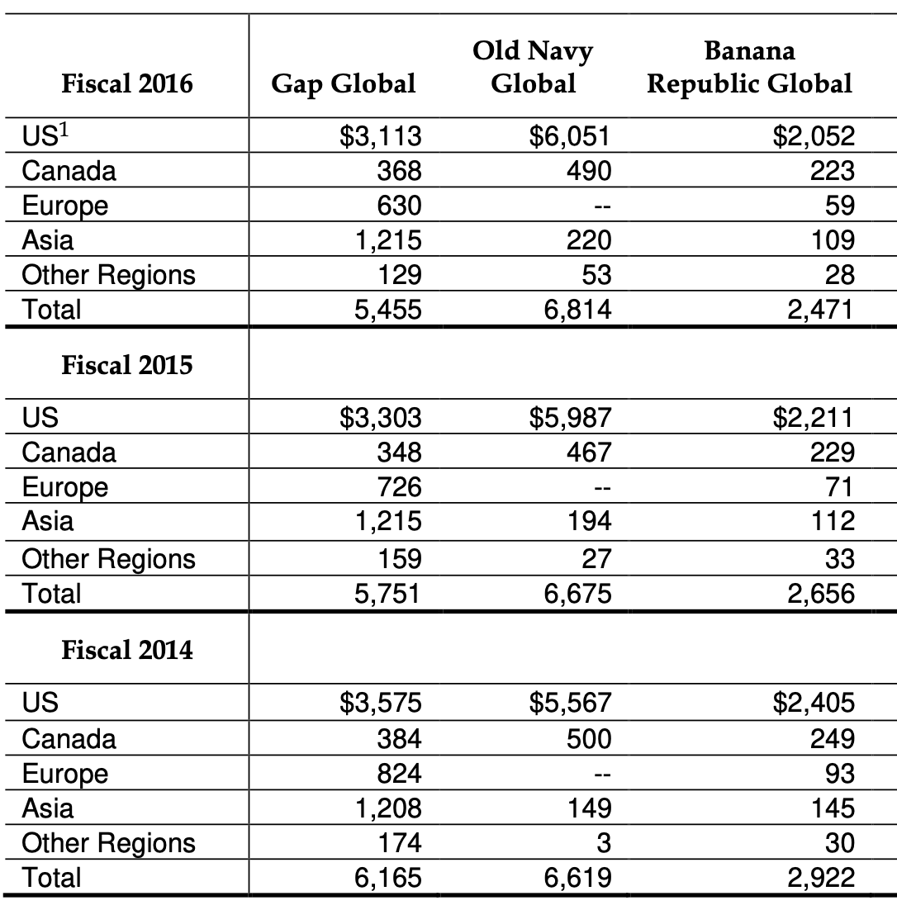
Gap Inc. segmented Net Sales ($ in millions)
Appendix
Gap : Highest sales in US, then Asia
There's a decline in sales in the US and Europe over the years, while sales in Asia remain relatively stable
Old Navy : Again, the US dominates sales across all years. There's a slight growth in sales in the US from 2014 to 2016. We also notice that Old Navy does not have any presence in Europe in the data provided
Banana Republic : The US again has the highest sales, but there's a decline over the years. There's also a decline in European sales, while Asian sales remain stable
Notes:
Photo by Markus Spiske on Unsplash

Slide 21
Thank you. Questions?

